Slide 1
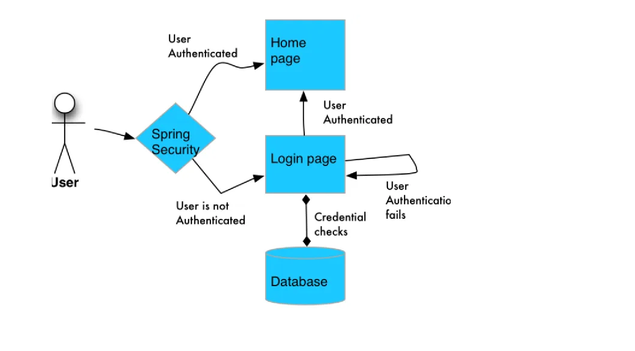
Security

Slide 2
What Are Authentication and Authorization?
Authentication is the equivalent of logging in with a username and password
Based on that username/password, an access control mechanism allows or disallows the user to perform certain tasks
Authorization is the equivalent of an Access Control List (ACL)
An AccessDecisionManager decides to allow/disallow access to a secure object based on the Authentication
Notes:
Before I get too far into the weeds, I want to make sure we’re clear on the difference between Authentication and Authorization, since even I catch myself confusing the two.
To explain Authentication, think of a simple username and password. Based on providing the correct username and password, some sort of mechanism allows the user to or prevents the user from performing certain tasks. For example, a username that is authenticated with a normal user role will normally not be allowed to delete other users accounts.
On the other hand, as I mentioned earlier, Authorization is the equivalent of an Access Control List. Spring Security provides the AccessDecisionManager interface and three implementations to allow AffirmativeBased, ConsensusBased, and UnanimusBased authorization to a secured object.

Slide 3
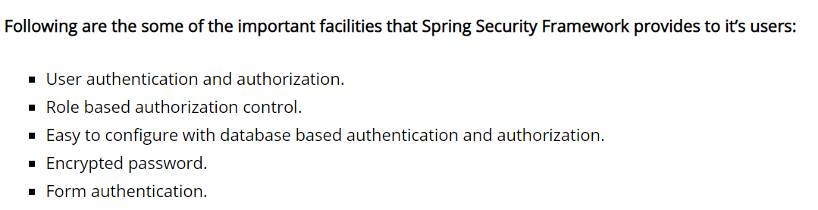
Security

Slide 4
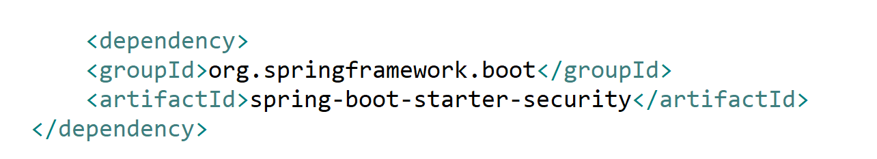
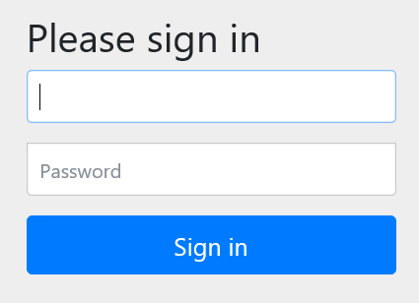
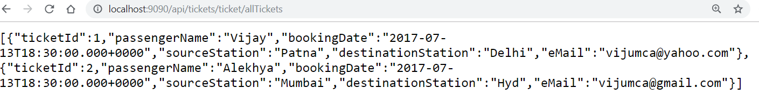
UserName: user

Slide 5
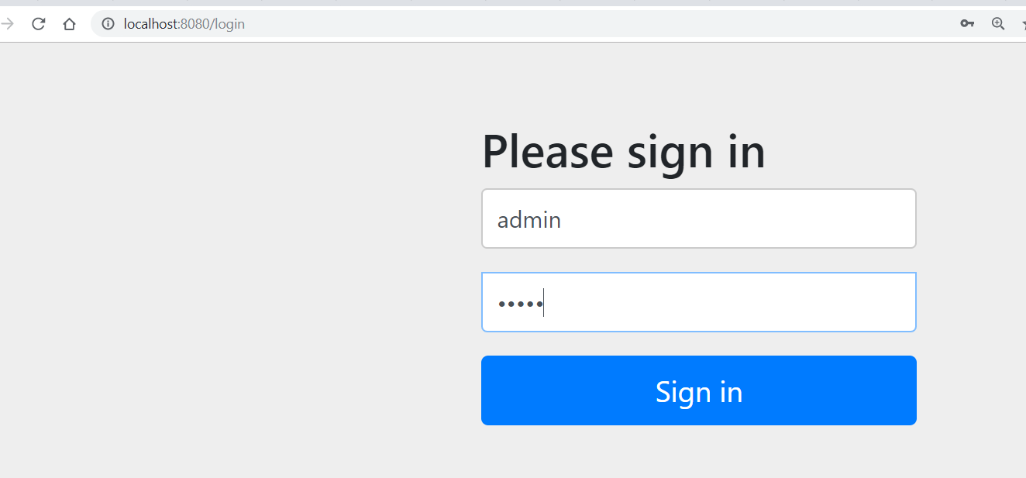
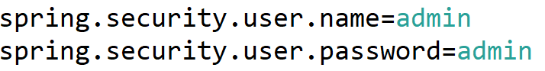
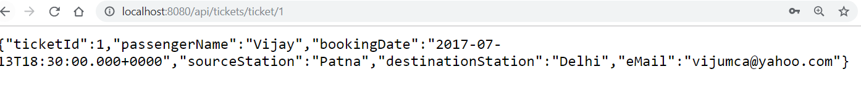

Slide 6
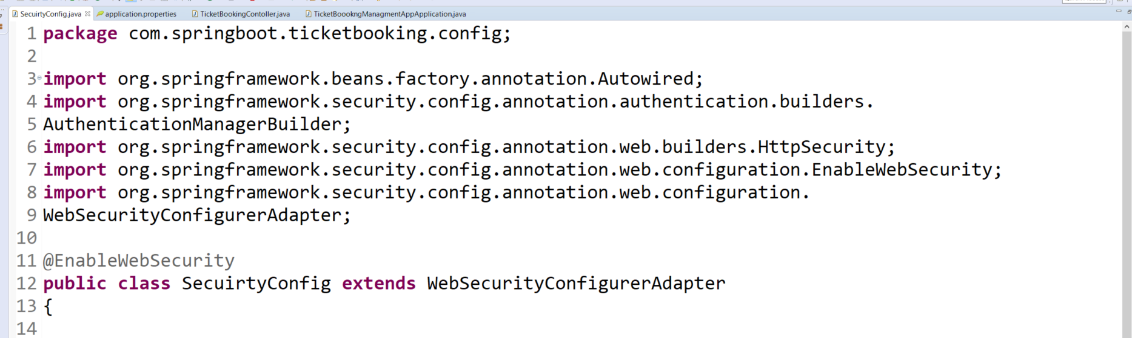
In Memory Authentication

Slide 7
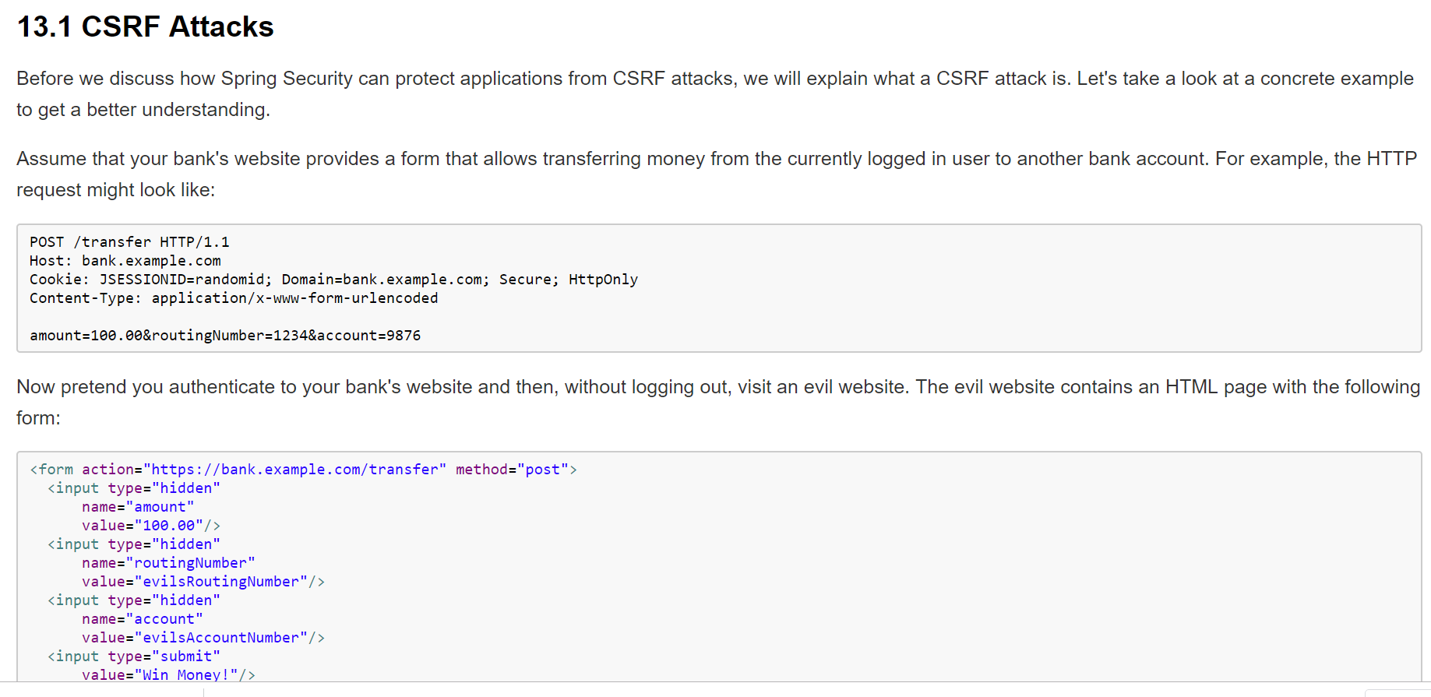
CSRF Attack - Overview

Slide 8
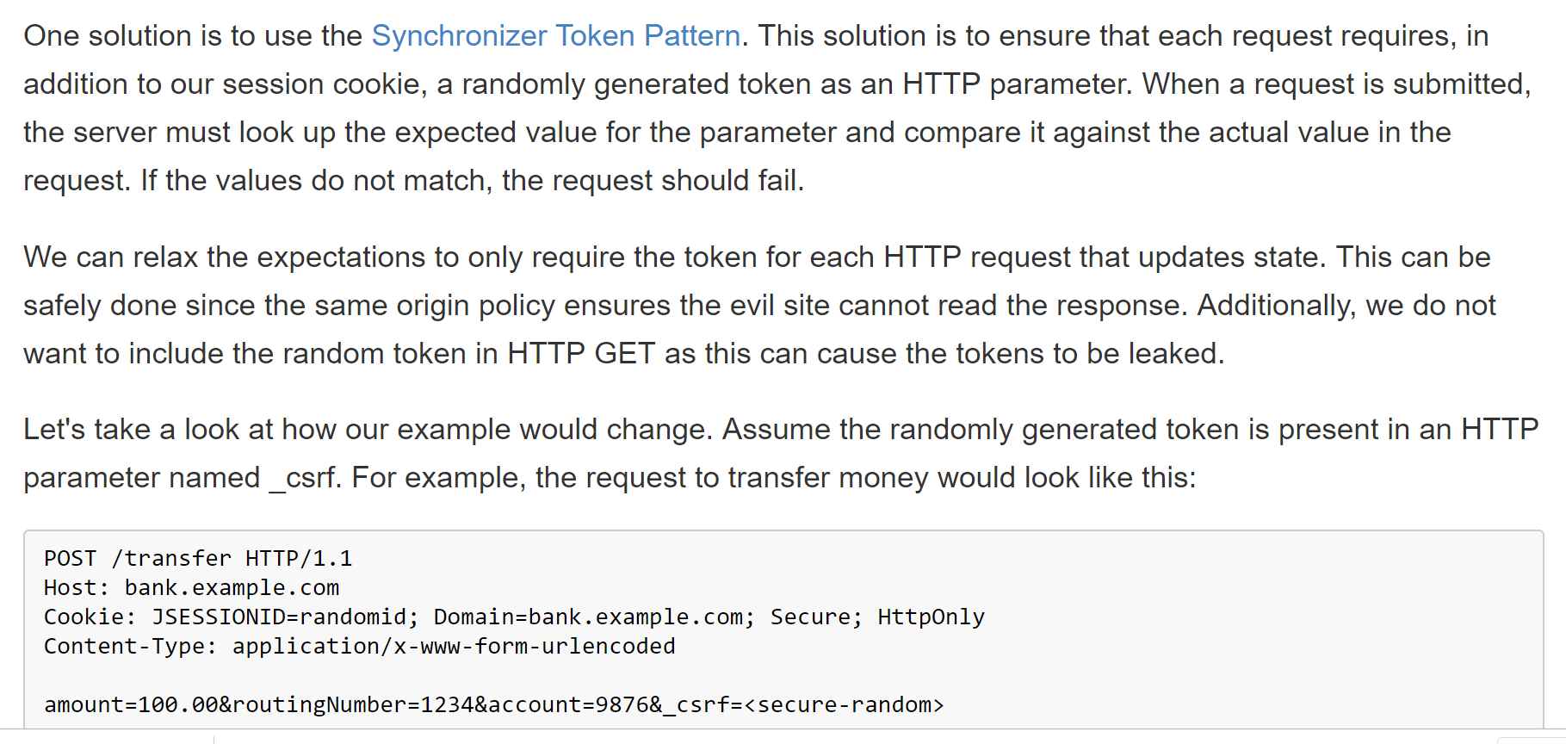
CSRF Attack - Overview

Slide 9
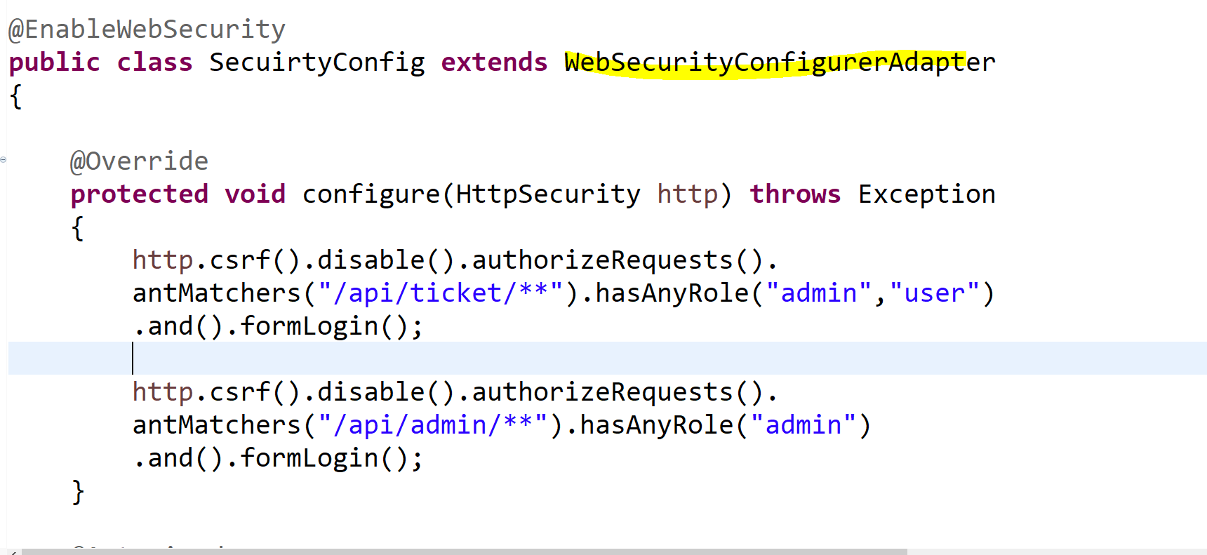
In Memory Authentication

Slide 10
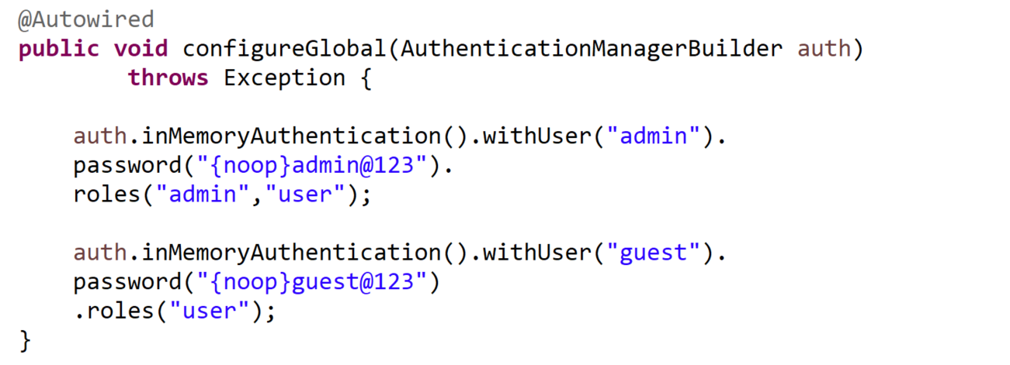
In Memory Authentication
{noop} -> DelegatingPasswordEncoder

Slide 11
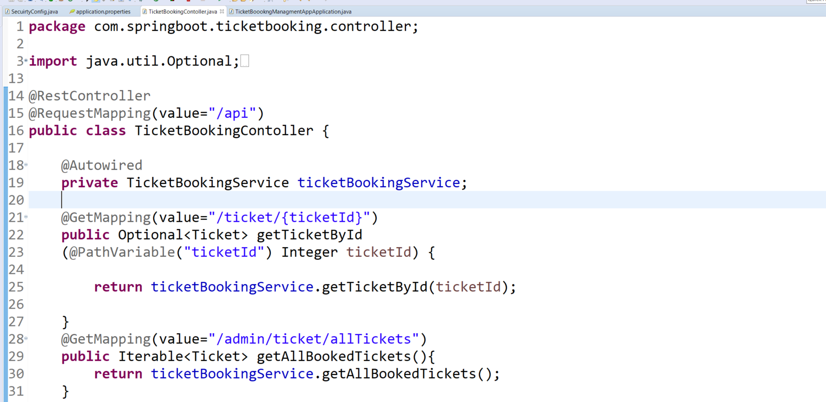
In Memory Authentication

Slide 12
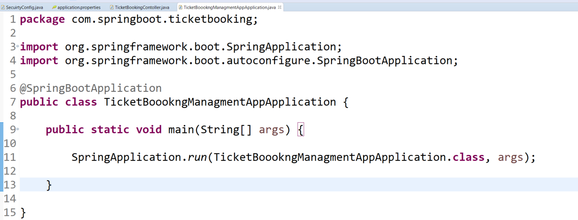
In Memory Authentication

Slide 13
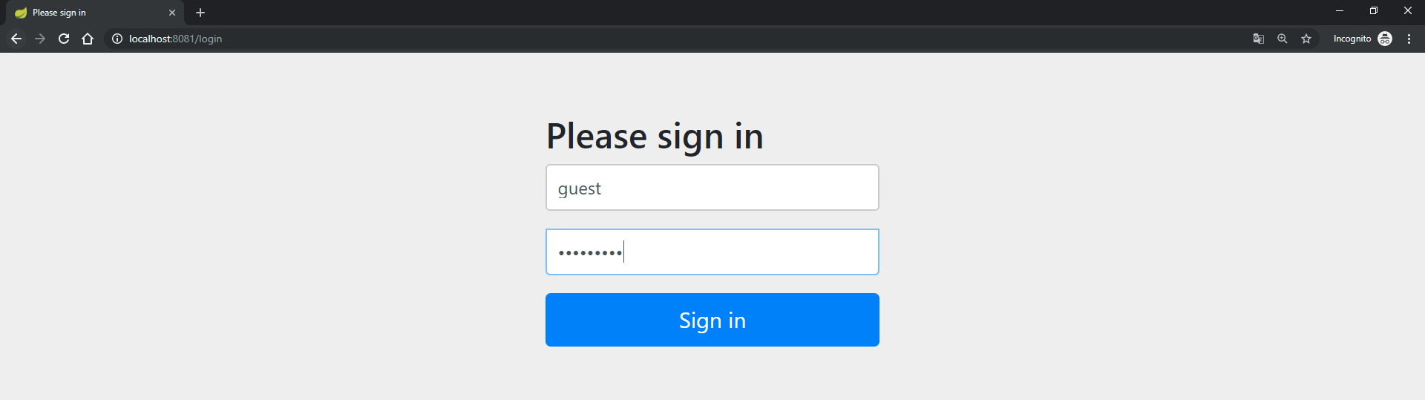
In Memory Authentication
URL : http://localhost:8081/api/ticket/1

Slide 14
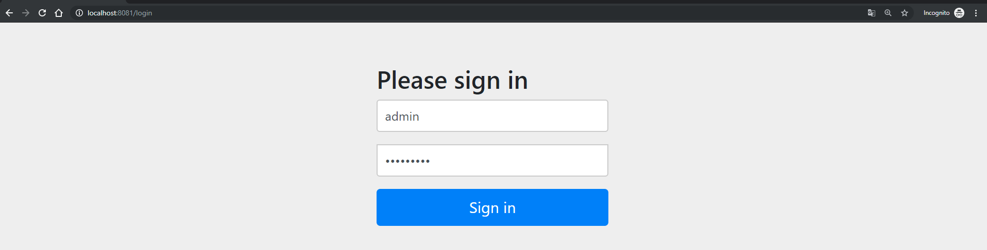
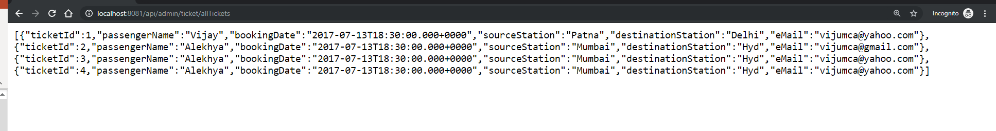
In Memory Authentication
URL : http://localhost:8081/api/admin/ticket/allTickets

Slide 15
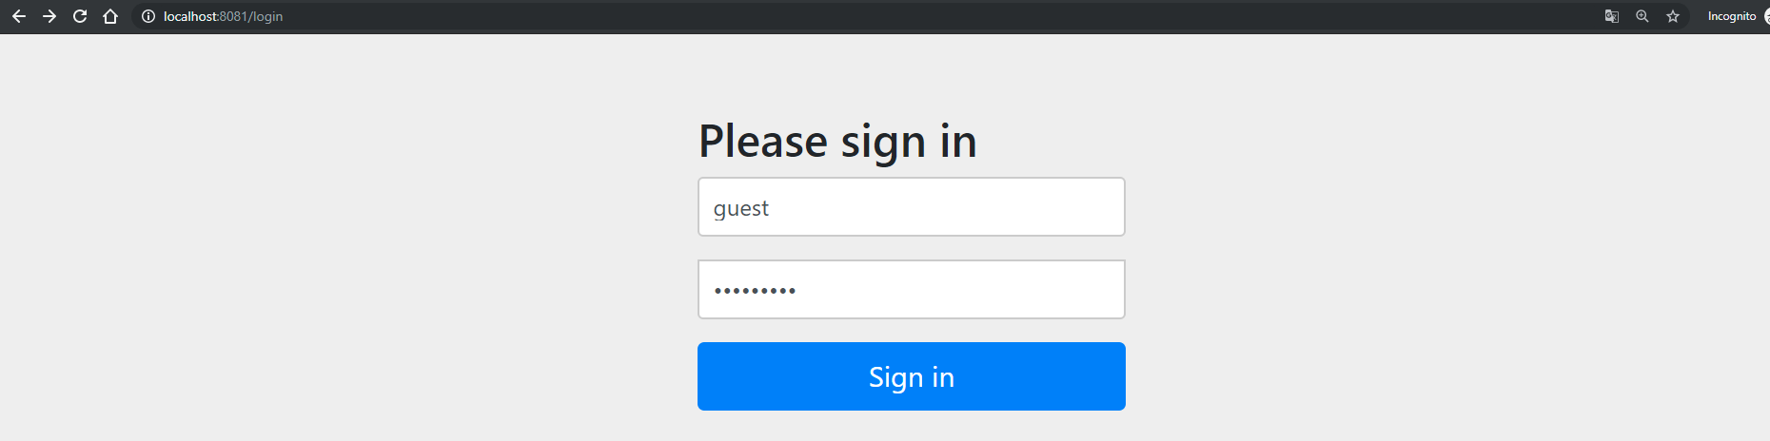
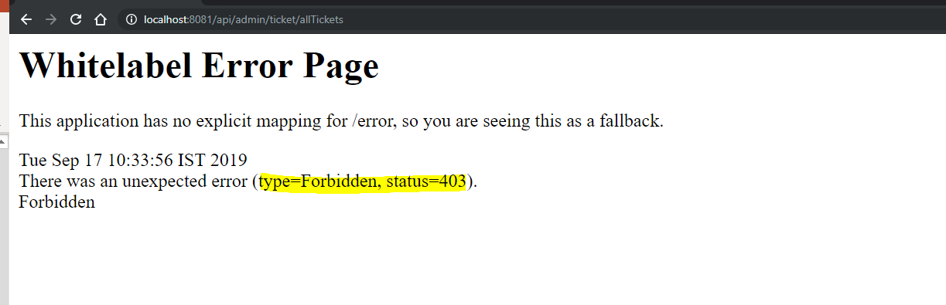
In Memory Authentication
URL : http://localhost:8081/api/admin/ticket/allTickets

Slide 16
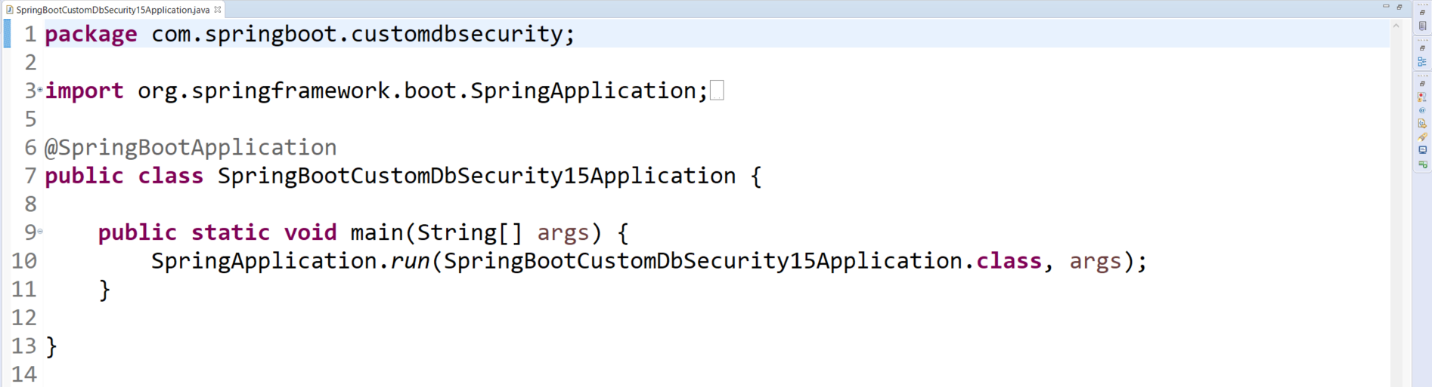
Security Using Database

Slide 17
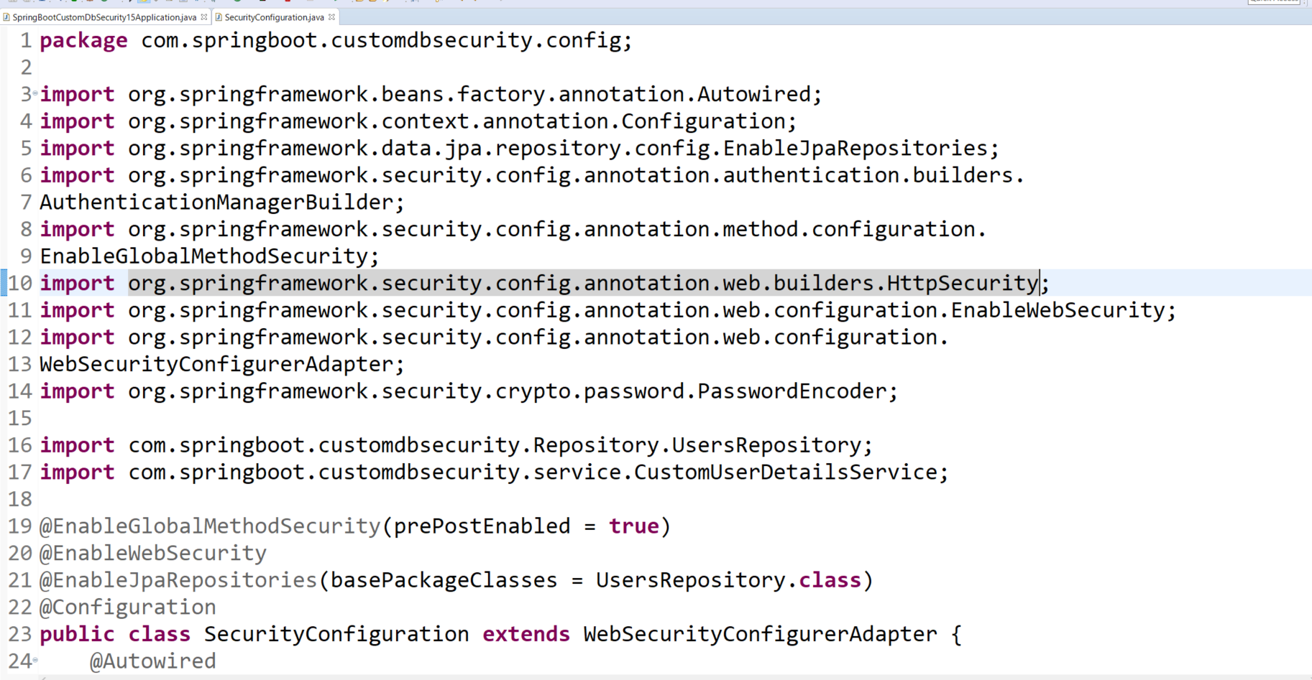
Security Using Database

Slide 18
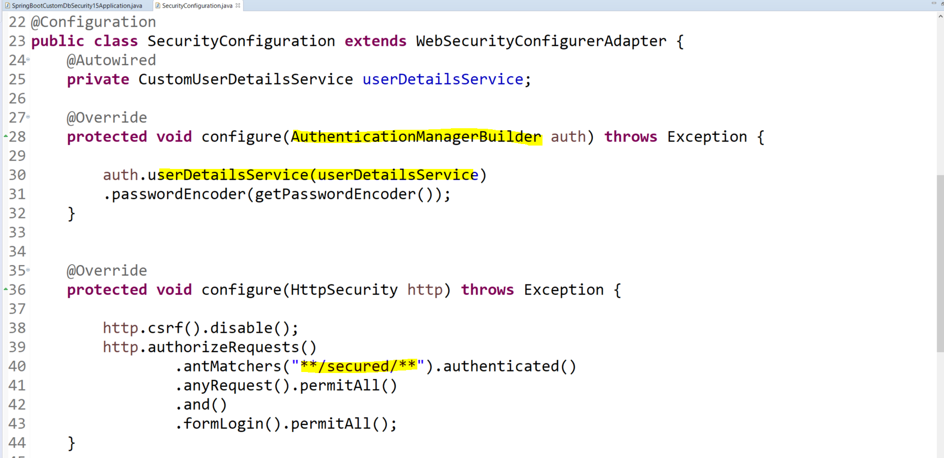
Security Using Database

Slide 19
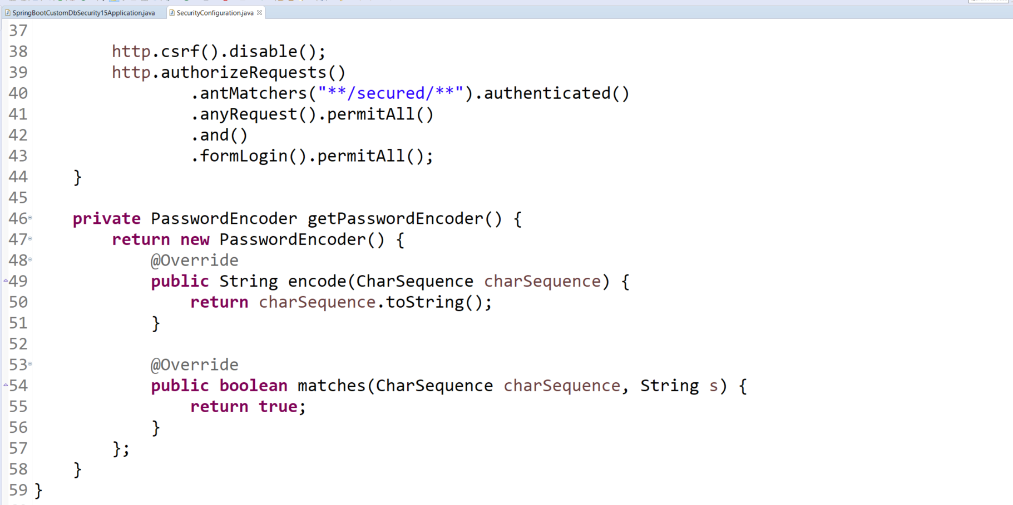
Security Using Database

Slide 20
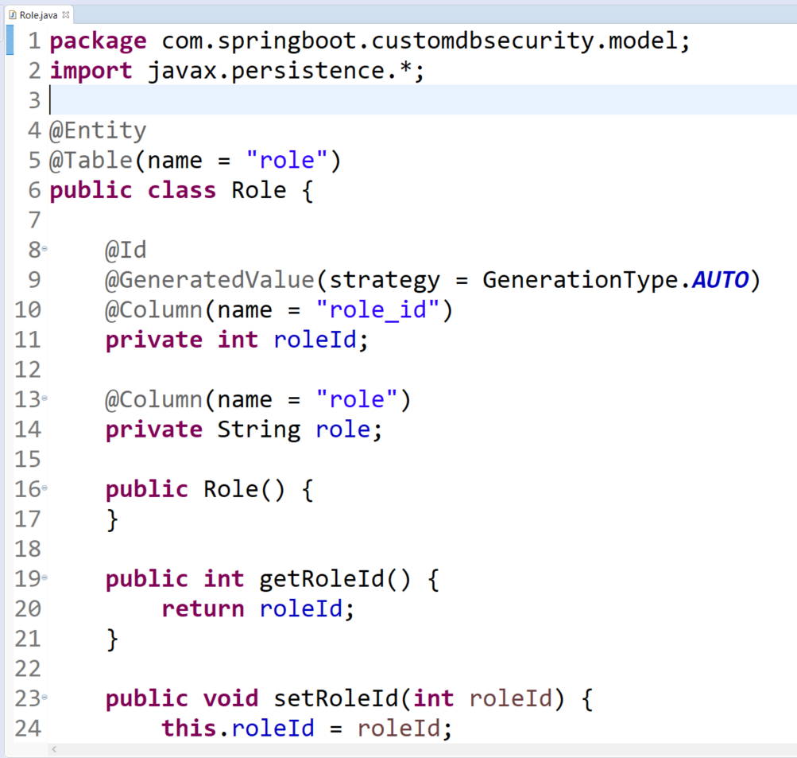
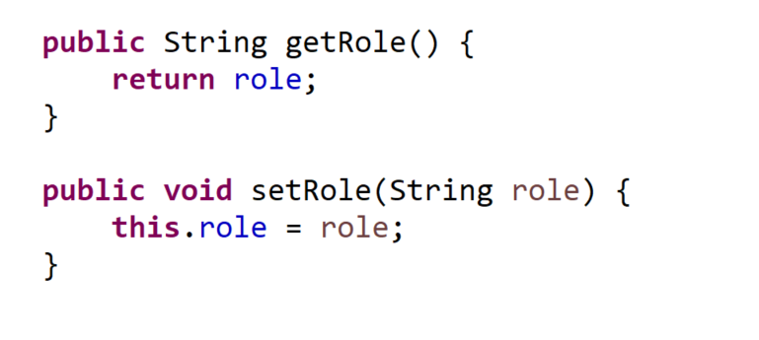
Security Using Database – Model

Slide 21
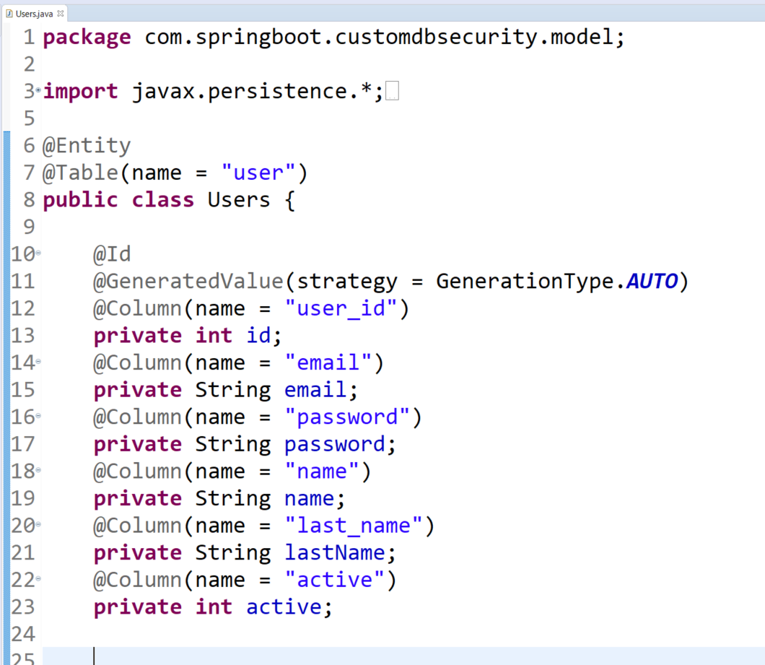
Security Using Database – Model

Slide 22
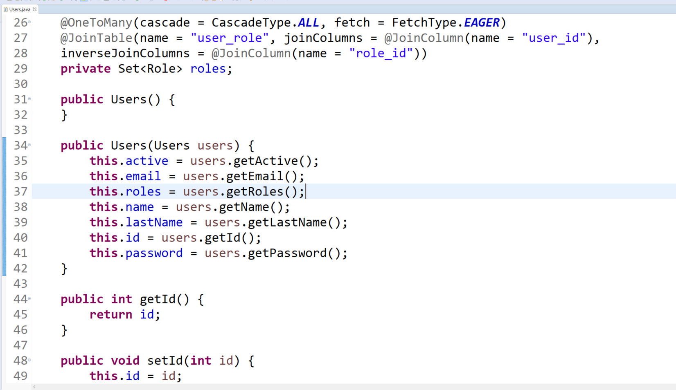
Security Using Database – Model

Slide 23
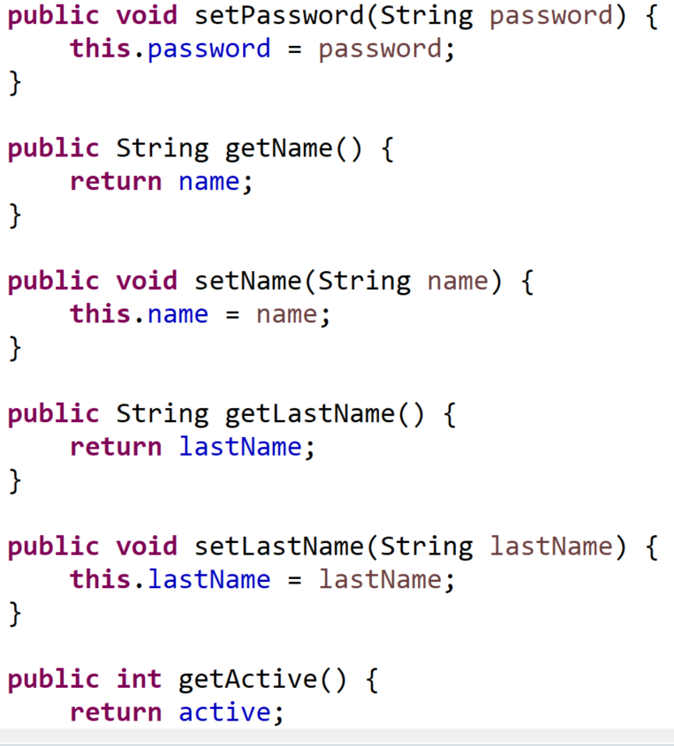
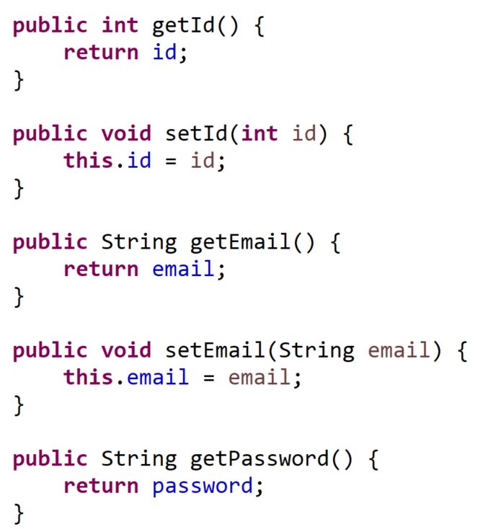
Security Using Database – Model

Slide 24
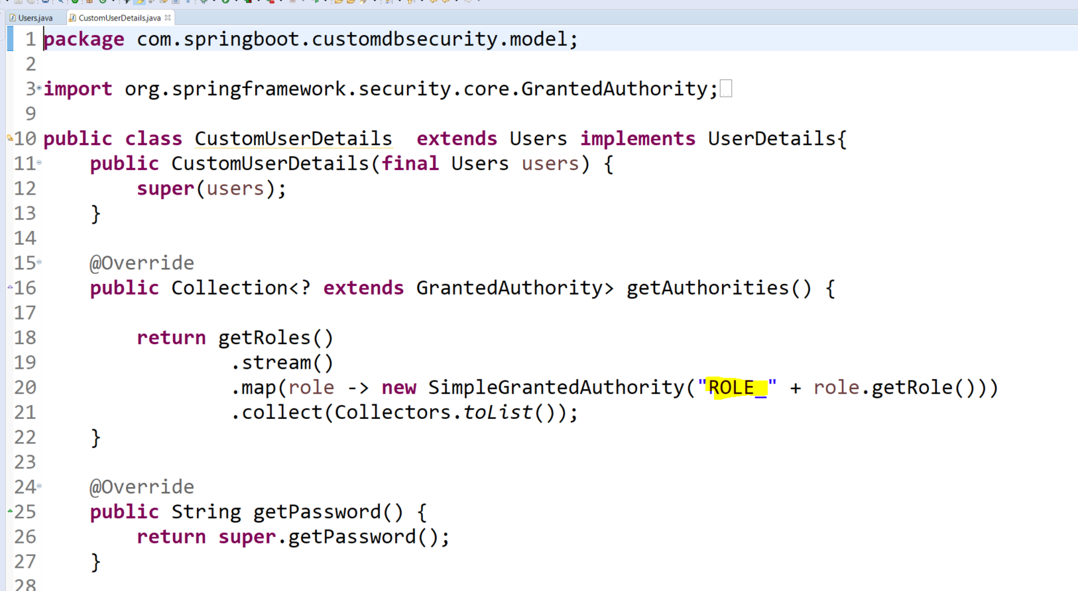
Security Using Database – Model

Slide 25
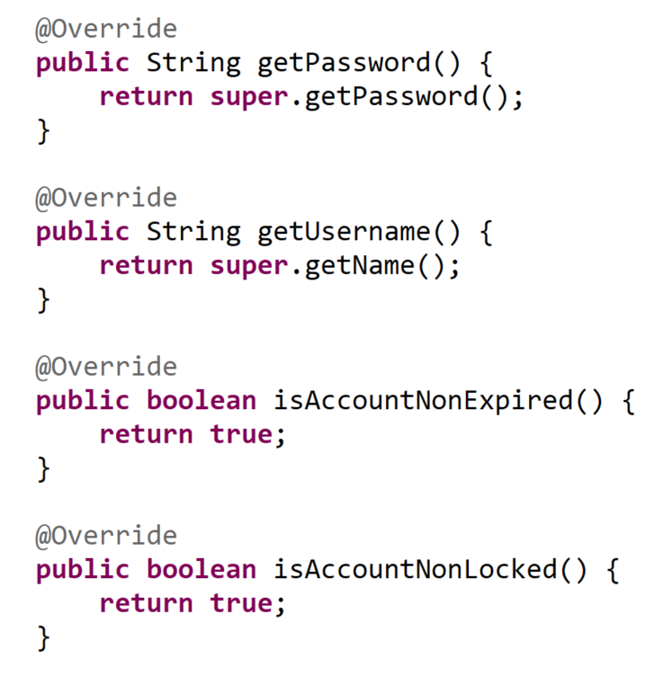
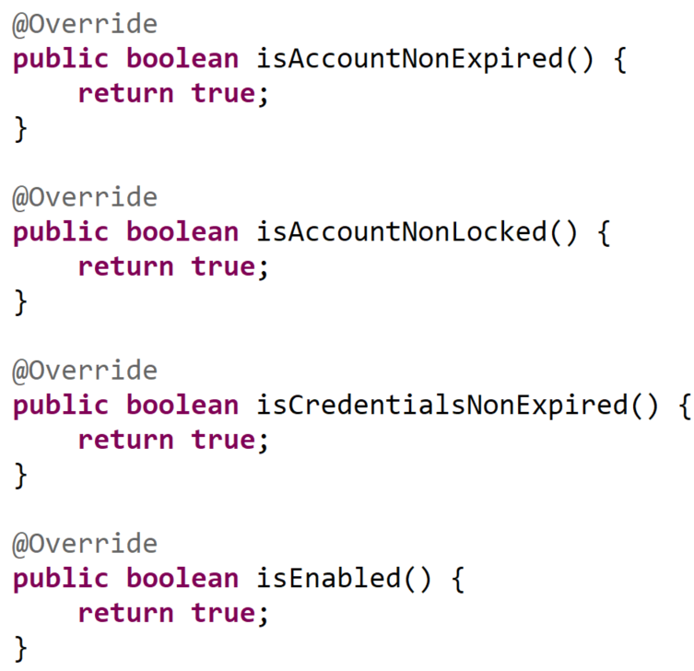
Security Using Database – Model

Slide 26
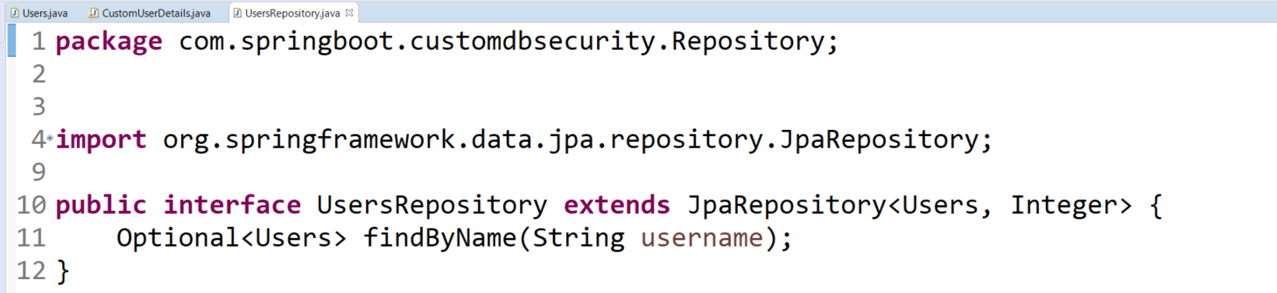
Security Using Database – DAO Layer

Slide 27
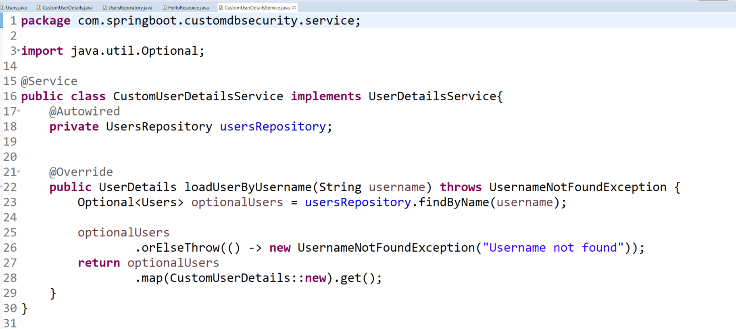
Security Using Database – Service Layer

Slide 28
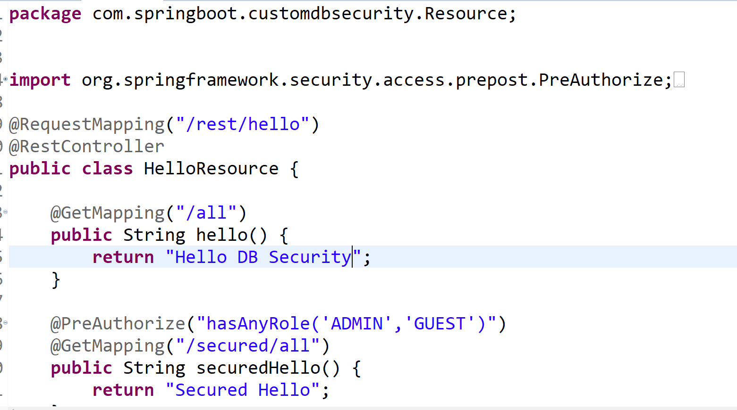
Security Using Database - Controller

Slide 29
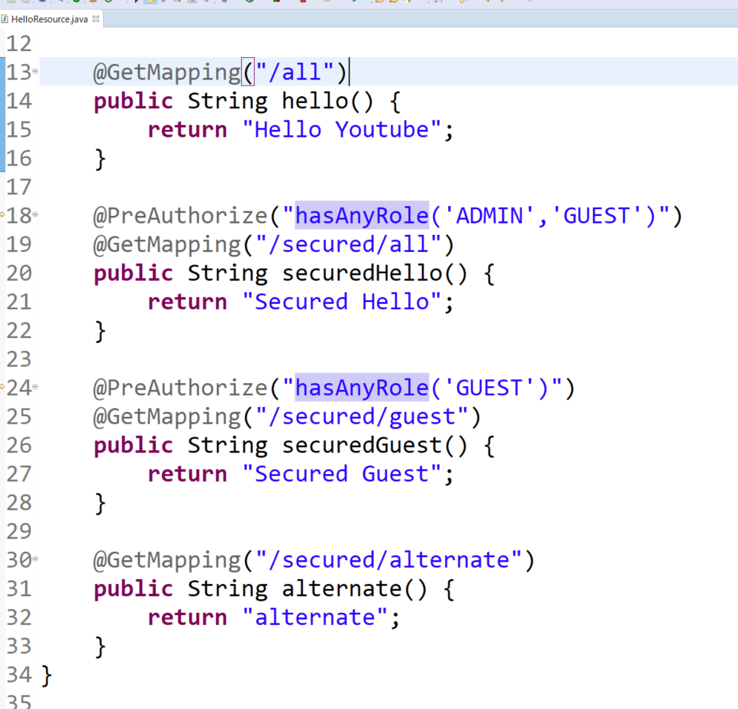
Security Using Database - Controller

Slide 30
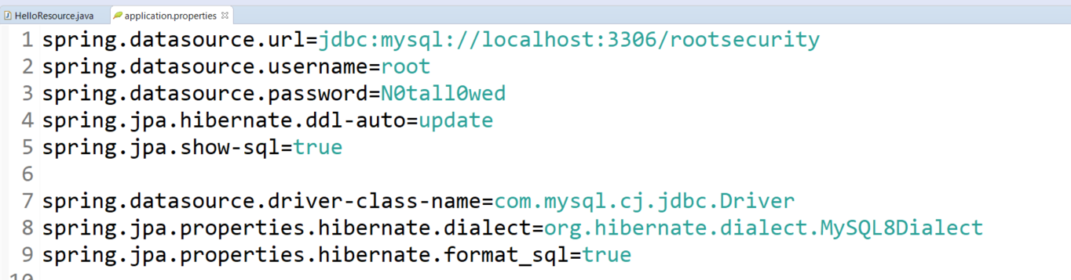
Application.properties

Slide 31
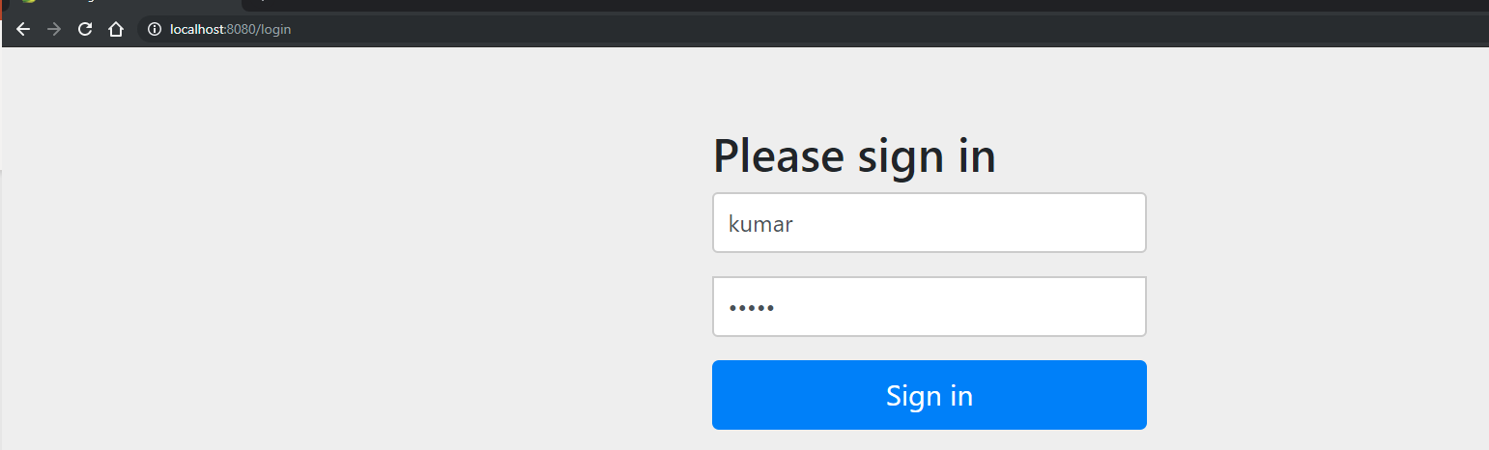
Security Using Database -Testing

Slide 32
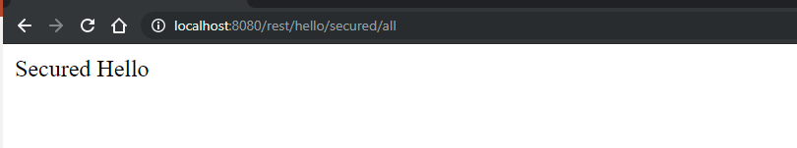
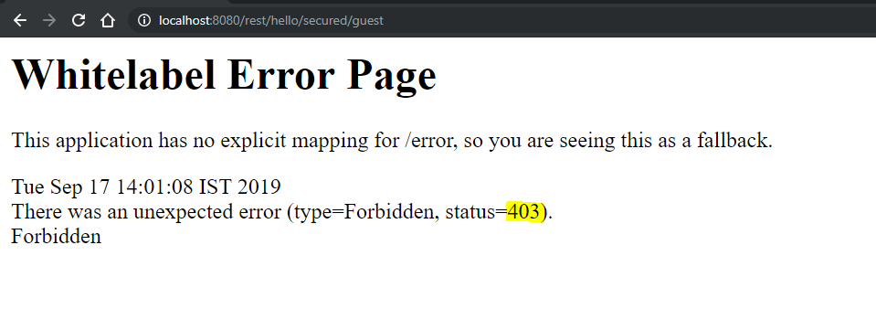
Security Using Database -Testing

Slide 33
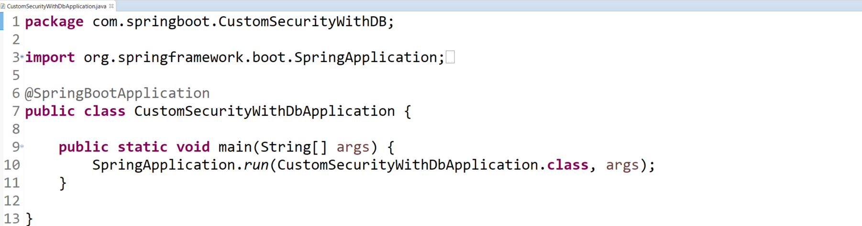
REST TEMPLATE

Slide 34
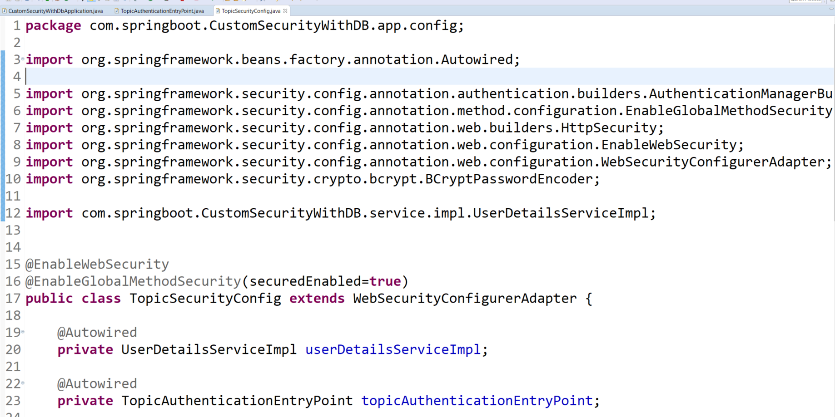
REST TEMPLATE – Security Logic

Slide 35
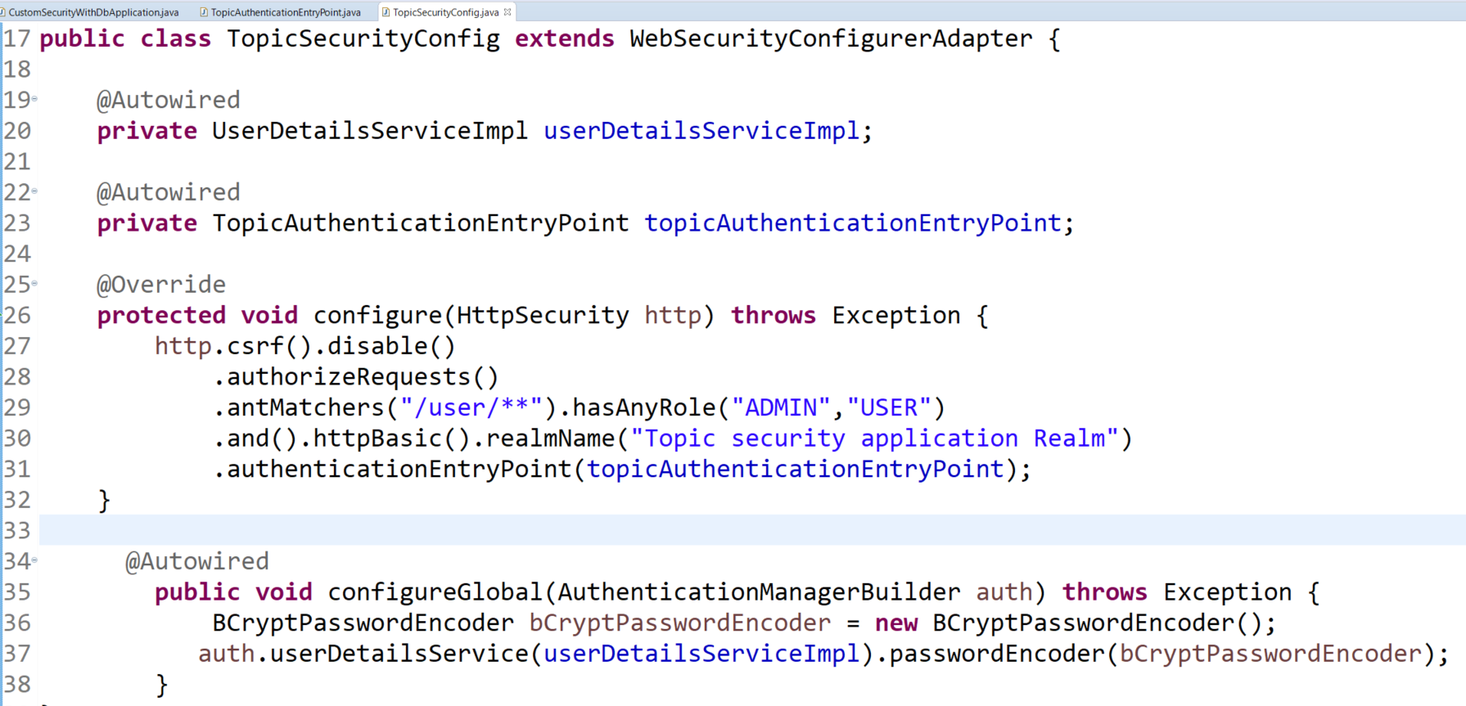
REST TEMPLATE – Security Logic

Slide 36
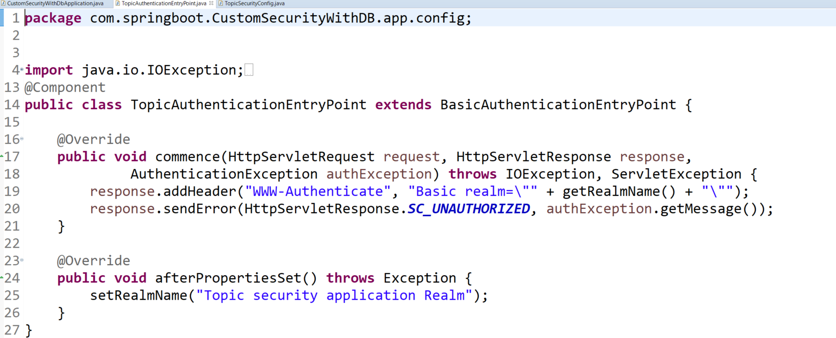
REST TEMPLATE – CUSTOM ERROR

Slide 37
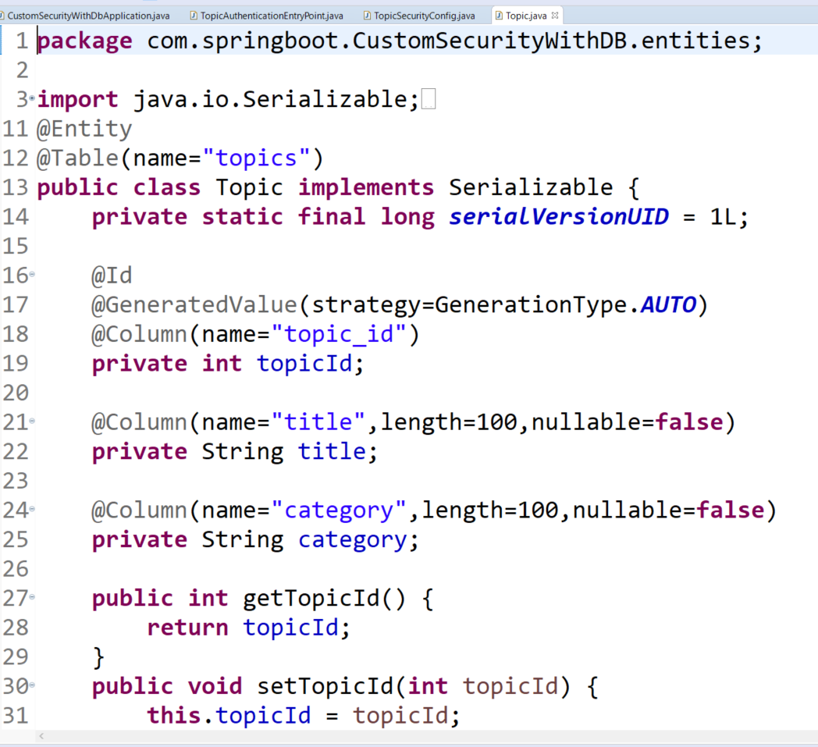
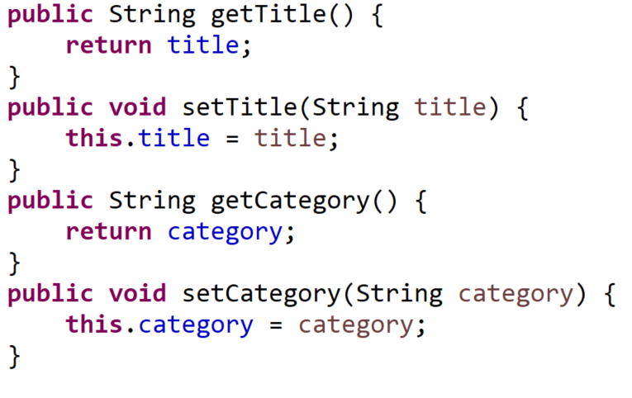
REST TEMPLATE - Entities

Slide 38
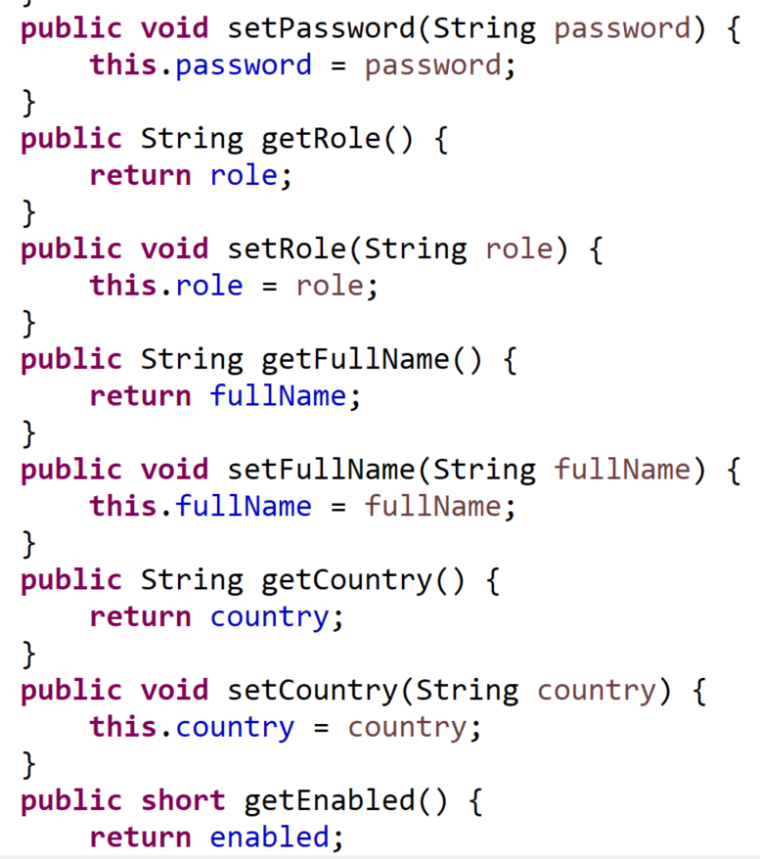
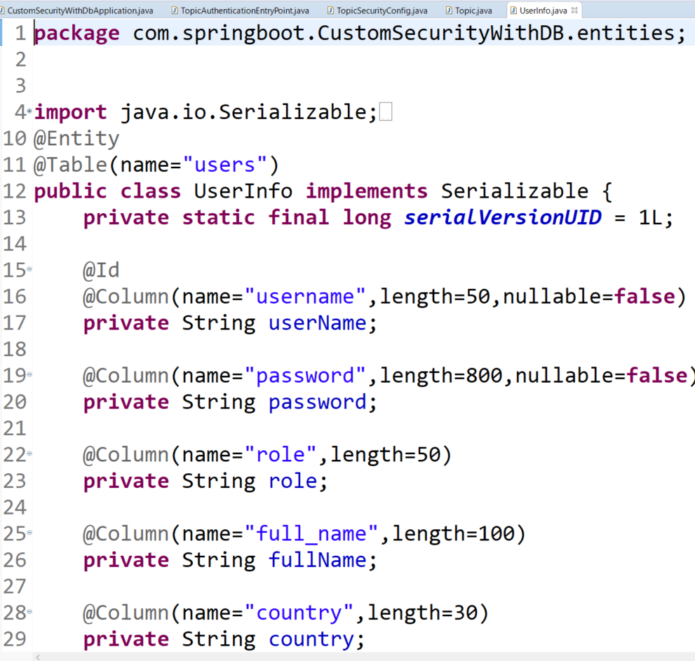
REST TEMPLATE - Entities

Slide 39
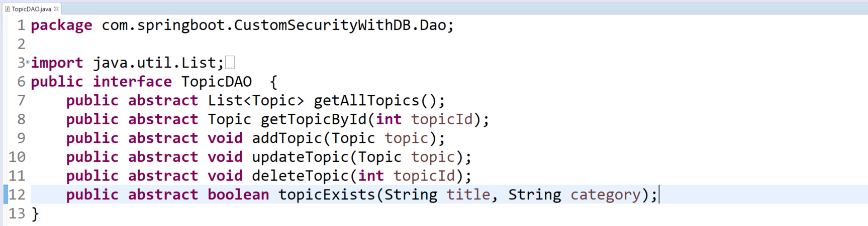

REST TEMPLATE

Slide 40

REST TEMPLATE

Slide 41

REST TEMPLATE

Slide 42

REST TEMPLATE

Slide 43

REST TEMPLATE

Slide 44

REST TEMPLATE - SERVICE

Slide 45


REST TEMPLATE - SERVICE

Slide 46

REST TEMPLATE SERVICE

Slide 47

REST TEMPLATE

Slide 48

REST TEMPLATE

Slide 49

REST TEMPLATE

Slide 50


REST TEMPLATE

Slide 51

REST TEMPLATE

Slide 52

APP PROPERTIES

Slide 53
REST TEMPLATE

Slide 54

OATH2

Slide 55
OATH2

Slide 56
OATH2

Slide 57
OATH2

Slide 58
OATH2

Slide 59
OATH2

Slide 60
OATH2

Slide 61
OATH2

Slide 62
OATH2

Slide 63
OATH2

Slide 64
OATH2

Slide 65
OATH2

Slide 66
OATH2

Slide 67
OATH2

Slide 68
OATH2

Slide 69
OATH2

Slide 70
OATH2

Slide 71
REST TEMPLATE

Slide 72
REST TEMPLATE

Slide 73
REST TEMPLATE

Slide 74
REST TEMPLATE

Slide 75
REST TEMPLATE

Slide 76
REST TEMPLATE

Slide 77

Custom with Refractoring

Slide 78
Custom Error class

Slide 79
Custom Error class

Slide 80
Custom Error class

Slide 81
UserName: user

Slide 83



Slide 84


Slide 85


